Slide 1

MemeNet
Made by: Kosogov Artem, Paul Tsiposchuk, Radjabli Elsever, Dmitry Pavlyuk, Doroshenko Renat

Slide 2


Slide 3
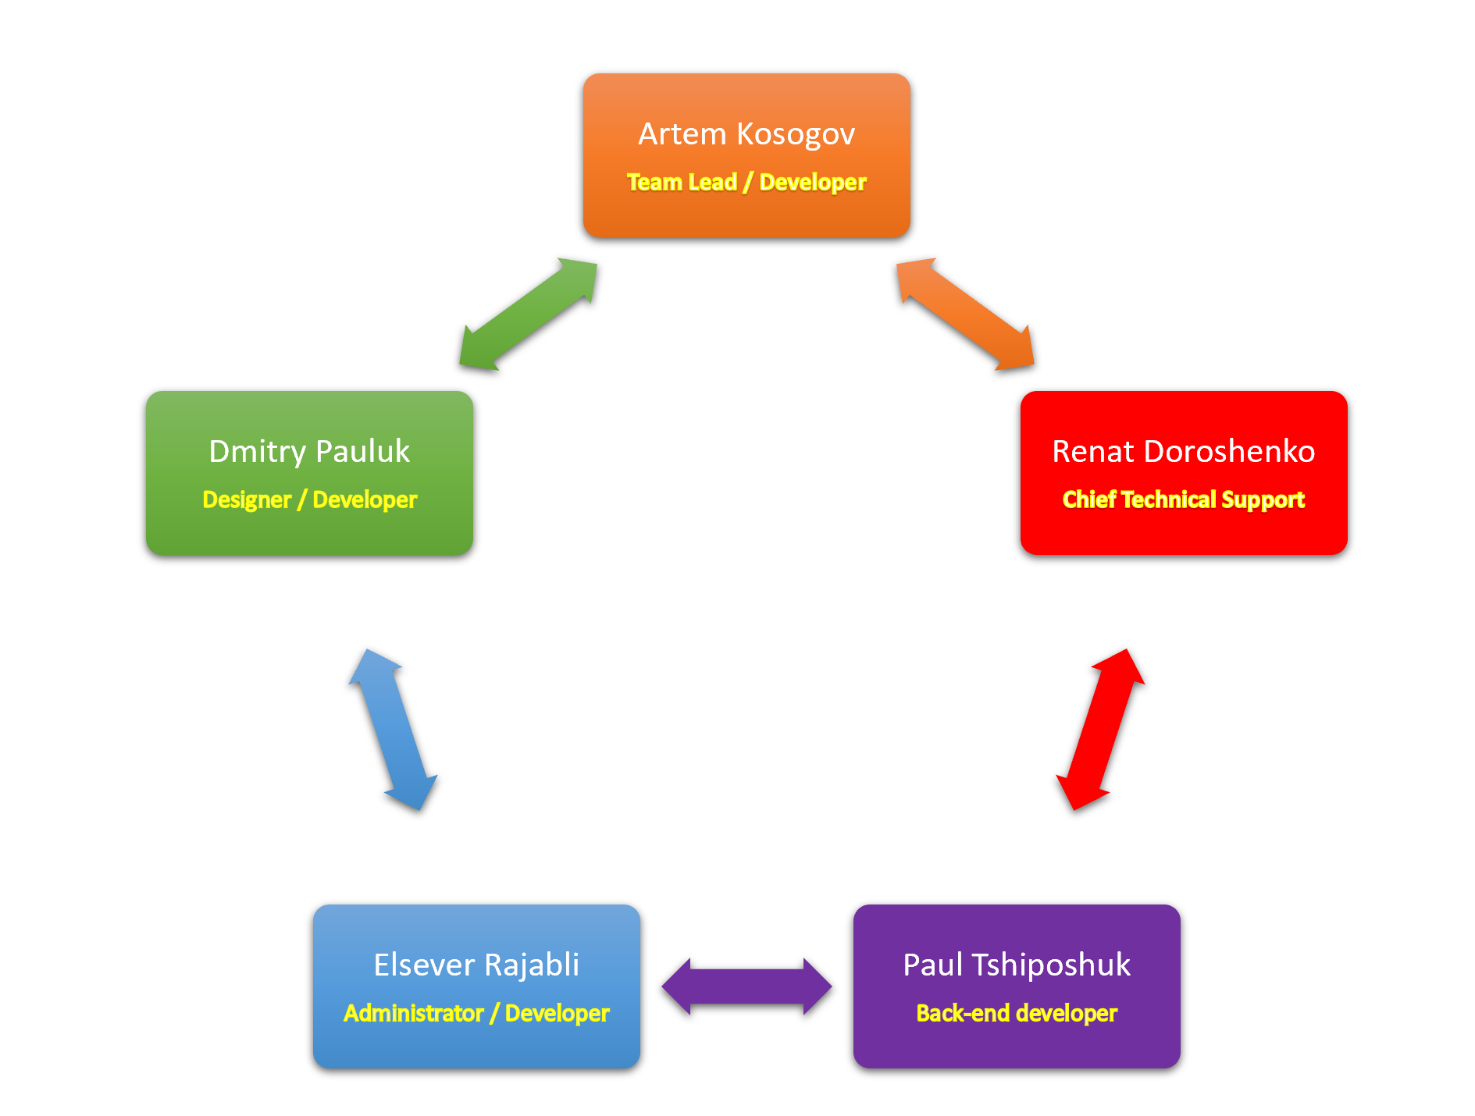
Team composition and structure

Slide 4
Analysis of the problem

Slide 5



Problem Statement
Users
Authors
Advertisers

Slide 6
Users problems
1. Search for funny images and videos
2. Difficulties in discussing memes
3. Limited ability to follow new memes
4.The difficulty of modifying existing memes

Slide 7
Authors problems
1. Audience search
2. Copyright issues
3. The difficulty of modifying existing memes
4. Need to get income

Slide 8
Advertisers Problems
1. Access to a young audience
2. Audience expansion
3. Convenient methods for advertising

Slide 9
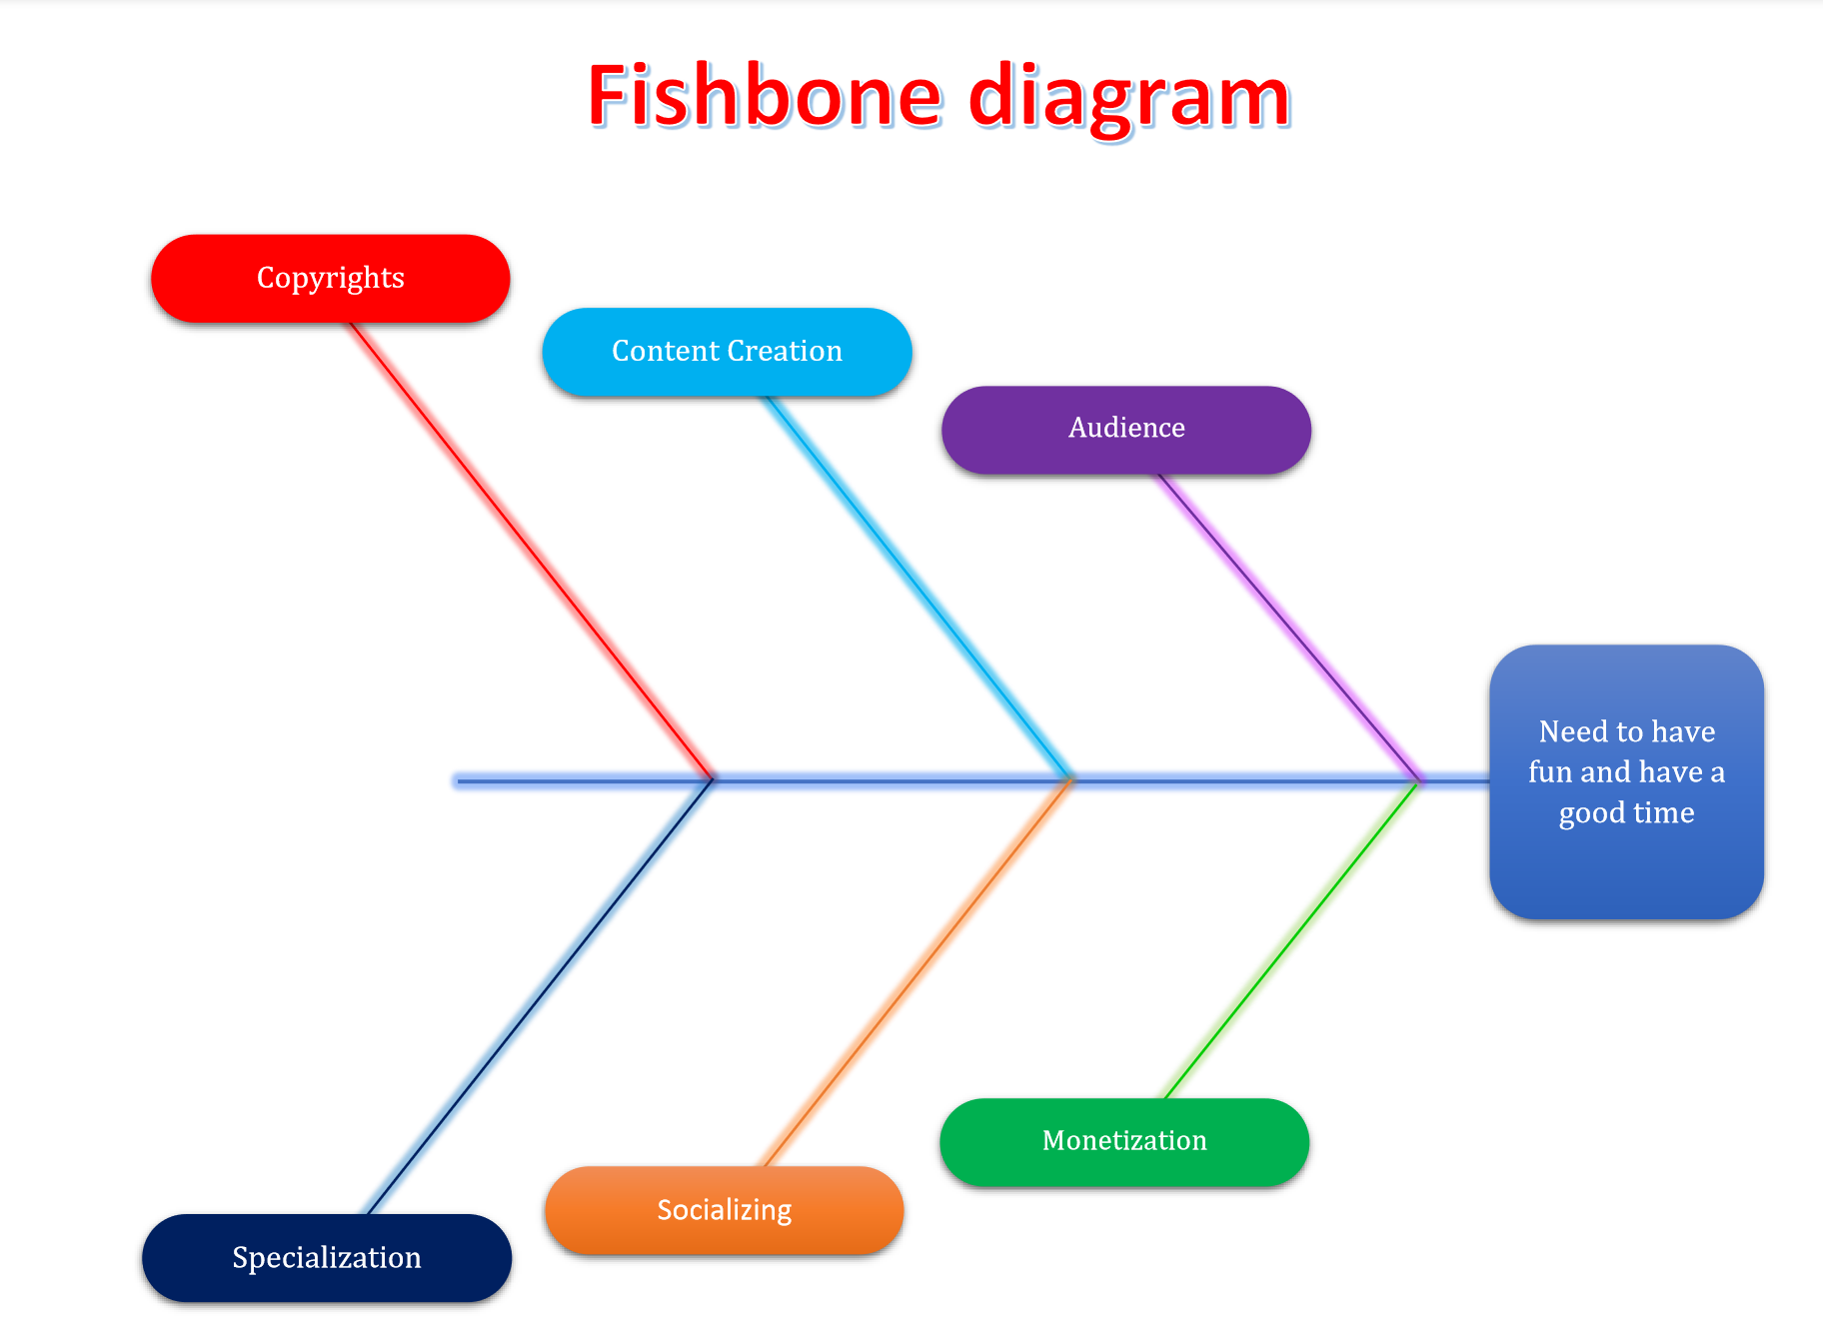
Understanding user needs

Slide 10
Pareto chart
1. When analyzing broad causes by looking at their specific components.
2. When there are many problems or causes and you want to focus on the most significant.
3. When analyzing data about the frequency of problems or causes in a process

Slide 11
Pareto chart
№ | Problem | Number of Cases | Number of Negative Cases
1 | Problem of finding humorous images | 29 | 32%
2 | Problem of finding humorous videos | 25 | 47%
3 | Poor adaptation of existing social networks for memes | 22 | 18%
4 | Difficulties in discussing memes | 21 | 22%
5 | The inconvenience of communication in the social networks with video memes | 19 | 23%
6 | The difficulty of get income for authors | 17 | 44%
7 | Limited ability to follow new memes | 15 | 33%
8 | The difficulty of modifying memes | 9 | 52%
9 | Authors' problems in finding an audience | 10 | 45%
10 | Problems with copyright on existing social networking | 12 | 90%

Slide 12
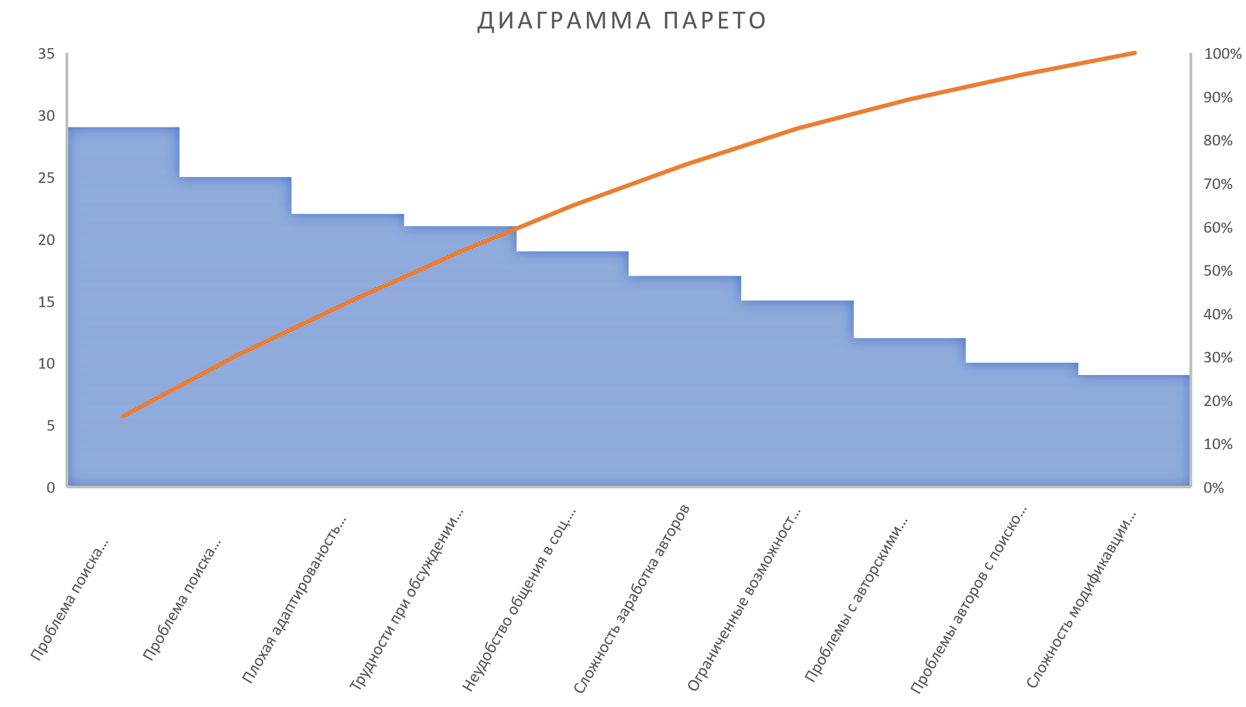
Pareto chart

Slide 13
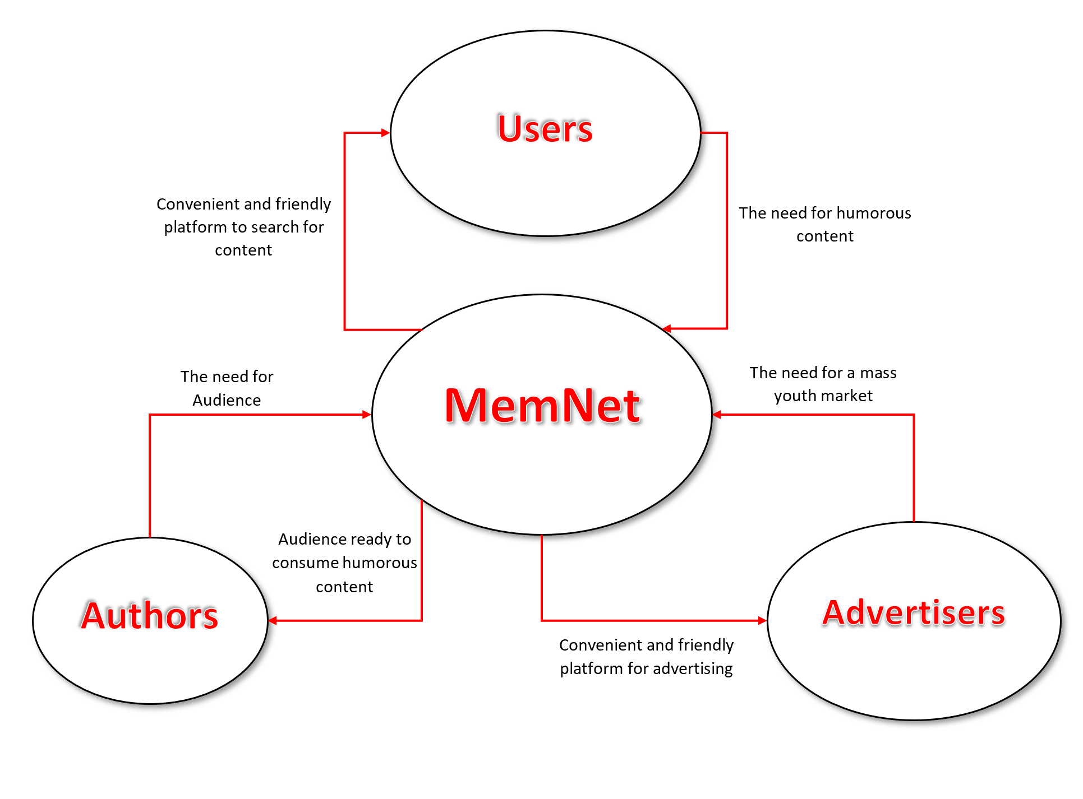
Boundaries of the solution system

Slide 14

Restrictions
1. Technical
2. Economical
3. Resources
4. Exploitation
5. Localization

Slide 15

Technical Restrictions

Slide 16

Economical Restrictions
1) Starting capital
2) Investments
3) Crowdfunding
4) Percentage of paid subscription.

Slide 17

Schedule Restrictions

Slide 18

Exploitation Restrictions
1) Server infrastructure
2) Call center, Customer Service
3) Team of programmers
4) A team of lawyers
5) PR department

Slide 19

Localization Restrictions

Slide 20
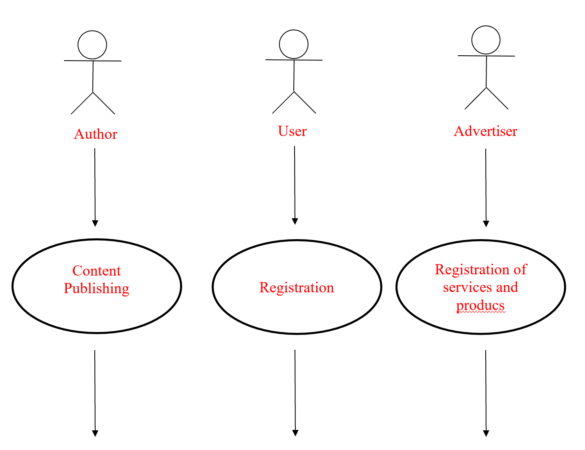
System Decomposition

Slide 21
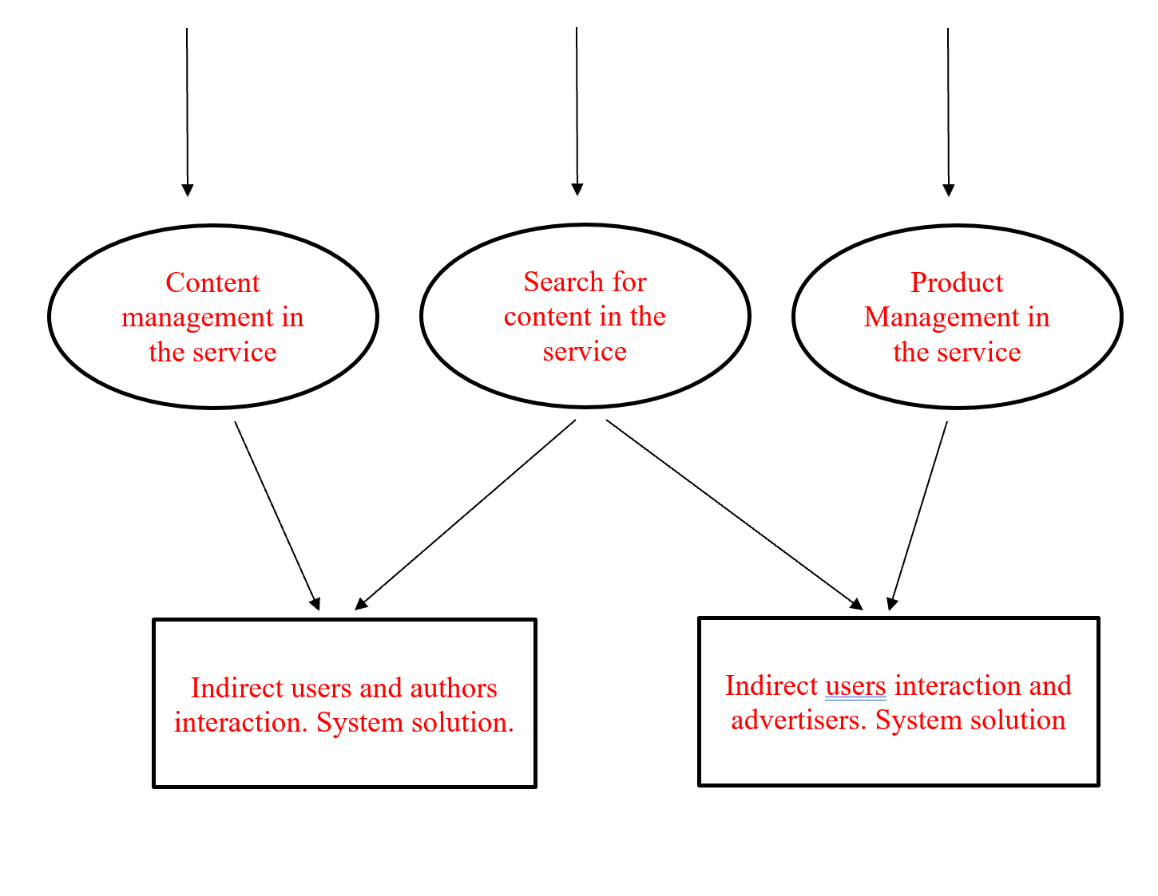
System Decomposition

Slide 22
Understanding user needs

Slide 23

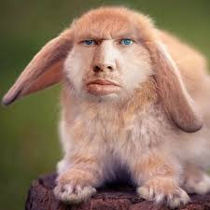
Interview
Name: Valeriy
Age: 54
Streamer
Name: Svetlana
Age: 43
Teacher
Name: Valentin
Age: 30
System administrator
Name: Evgeniy
Age: 22
HR Manager
Name: Ighor
Age: 26
Programmer
Name: Anastasiya
Age: 19
Student
Name: Valentina
Age: 55
Teacher

Slide 24

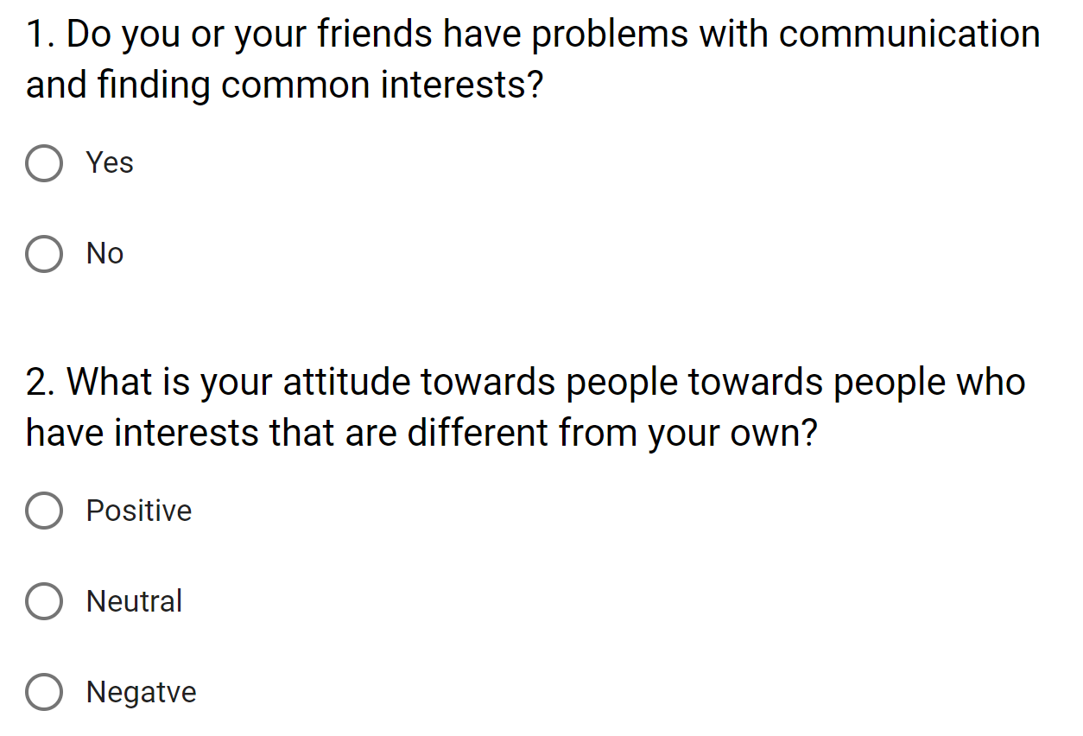
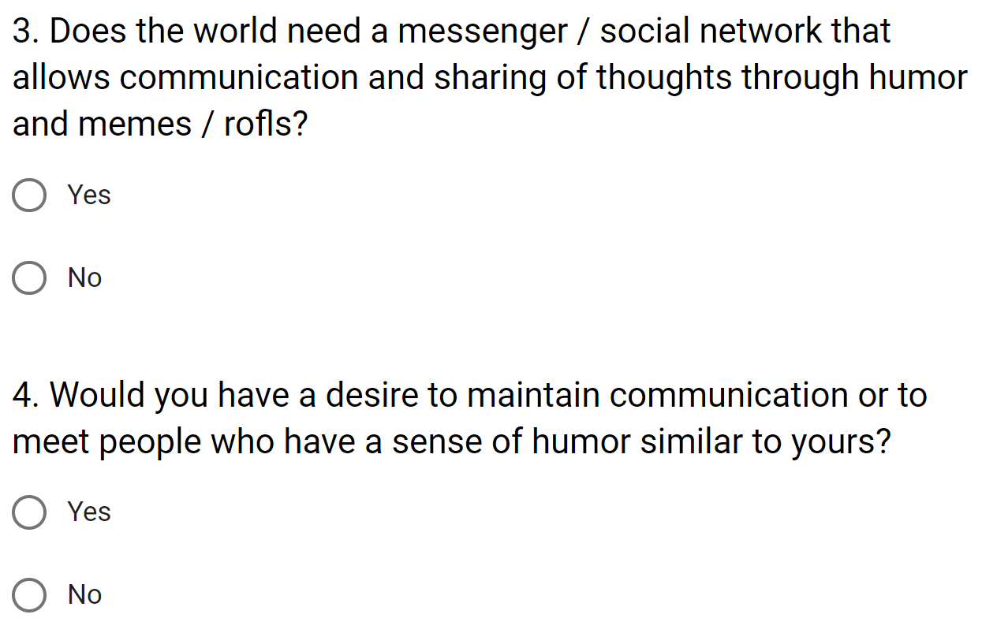
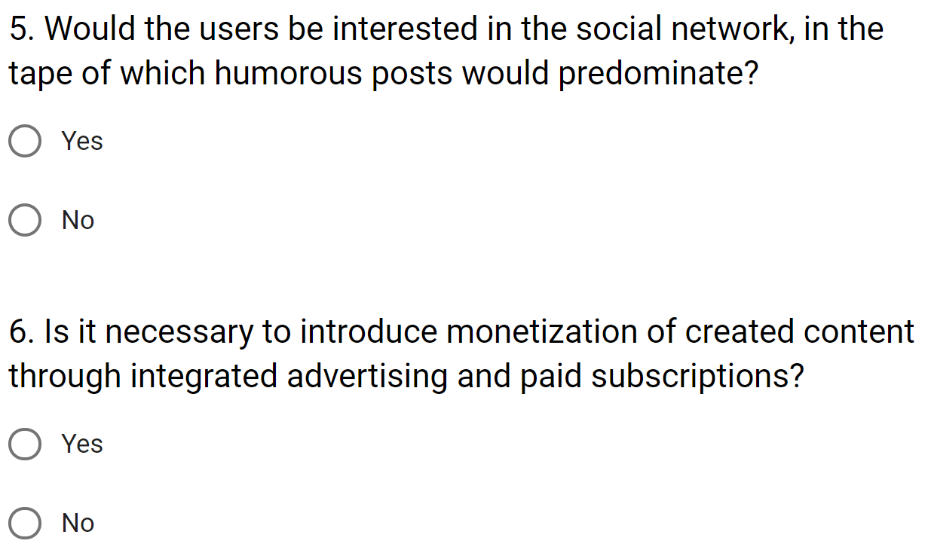
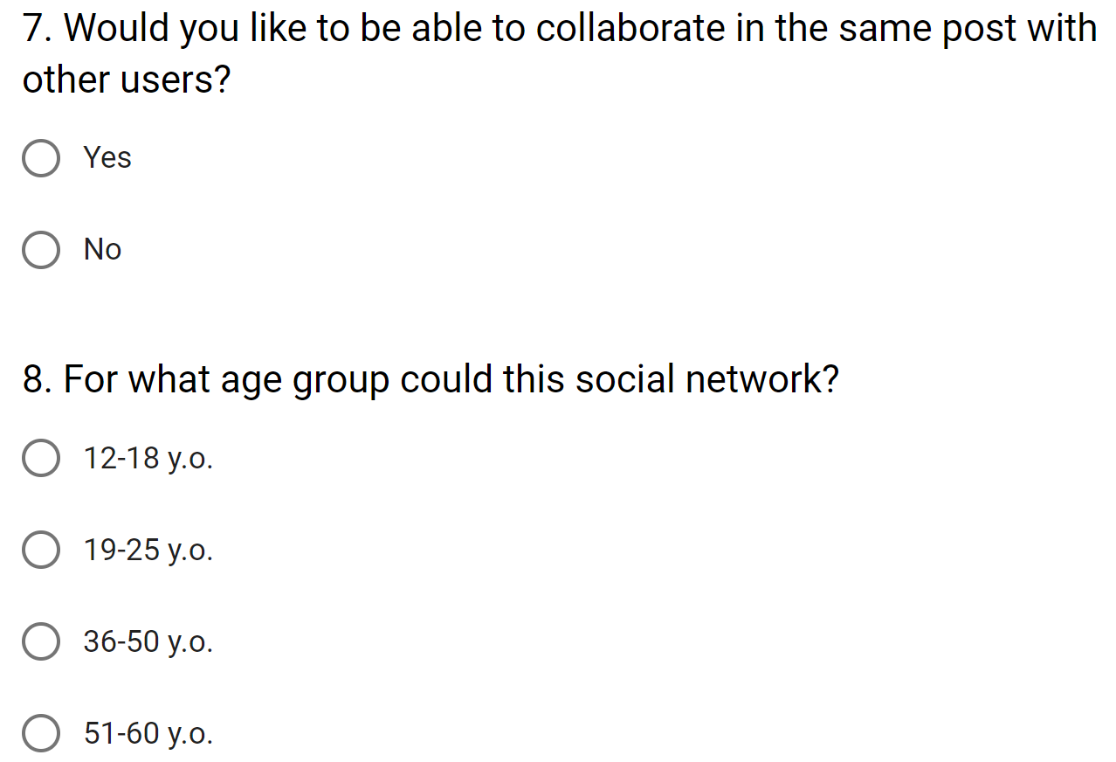
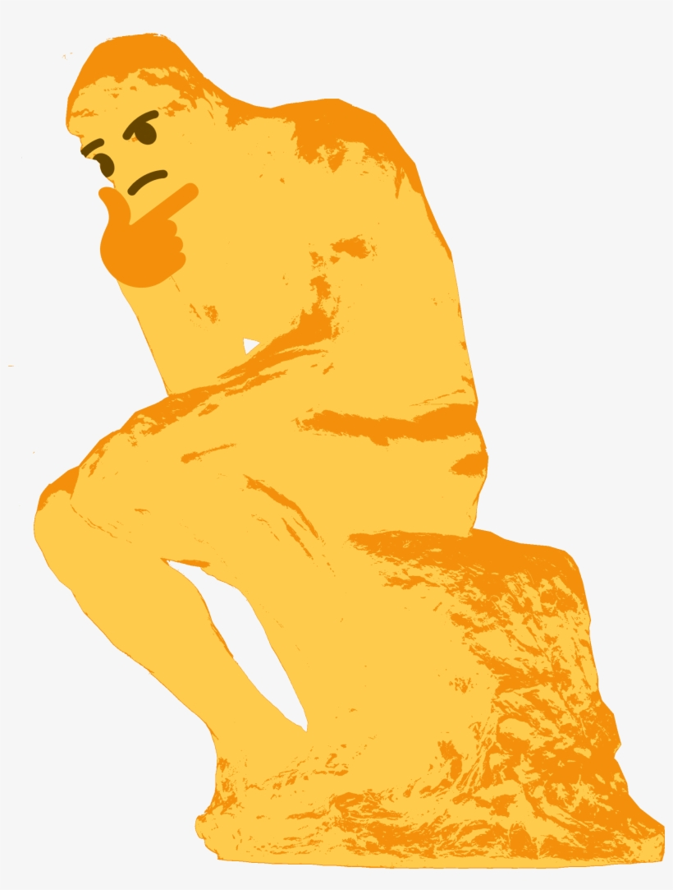
Questioning

Slide 25
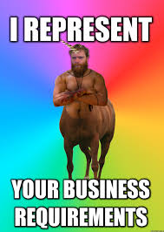
Requirments
1. The system must be available at any time.
2. Easy to use, intuitive interface.
3. The ability to both send / receive messages, and make their publications public.
4. Content monetization
...

Slide 26
Meeting and brain storm
Name | Role | Post
Kosogov Artem | Leading | Team leader & developer
Rajabli Elsever | Participant | Application and DB administrator
Dmitry Pavlyuk | Participant | Designer & developer
Pavel Tsiposhchuk | Participant | Backend developer
Doroshenko Renat | Participant | Head of product support department

Slide 27

Timetable
Schedule | Agenda item | Description
10:00 - 10:15 | Opening | Agenda, organization, rules
10:15 - 10:45 | Contextual discussion | Acquaintance with the prepared materials, the state of the project
10:45-11:15 | Speech | Intro of team leader
11:15 – 11:45 | Presentation | Explanation of the future project concepts
11:45 – 12:00 | Break | Ability to relax, smoke
12:00 – 13:00 | Brainstorm | Stage of ideas generation
13:00 – 13:30 | Lunch break | The ability to think over ideas in a different setting
13:30 – 15:00 | Brainstorm | Stage of ideas generation
15:00 – 15:20 | Result | Summing up, possible minor modifications of the generated functions
15:20 – 15:40 | Ending | The opportunity to communicate with the team, the administration in a more relaxed atmosphere

Slide 28
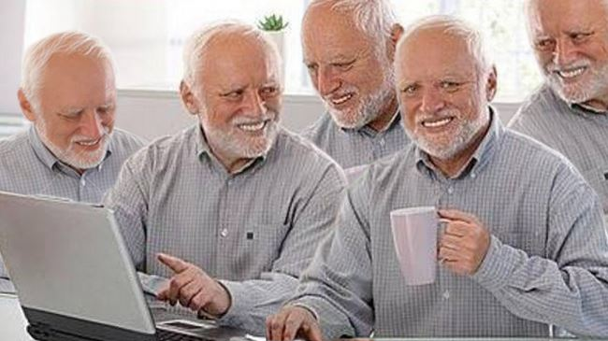
Bill of users rights
We publicly declare that all users who have applied to our service are entitled to:
confidentiality of personal information;
protection of personal information;
reliability of the provided data;
possession of intellectual property;
system accuracy;
permanent and reliable connection and efficient operation.

Slide 29

Precedent usage

Slide 30
CRC-Card
Object | Administrator
Duty (behavior) | Resolves all conflicts that have arisen. Control ranking system. Organizes events within the social network.
Interactions (with which of the modeled entities does the object interact) | Interacts with the developers team, the administrator of a database (if necessary), with clients (if necessary).
CRC-Card
Object | Administrator of the DB
Duty (behavior) | Servicing and troubleshooting server, load balancing.
Interactions (with which of the modeled entities does object interact) | Interacts with administrators, developer team (if needed).
CRC-Card
Object | Moderator
Duty (behavior) | Content censoring, locking/unlocking users.
Interactions (with which of the modeled entities does the object interact) | Interacts with administrators, with clients.

Slide 32

Prototype GUI

Slide 33
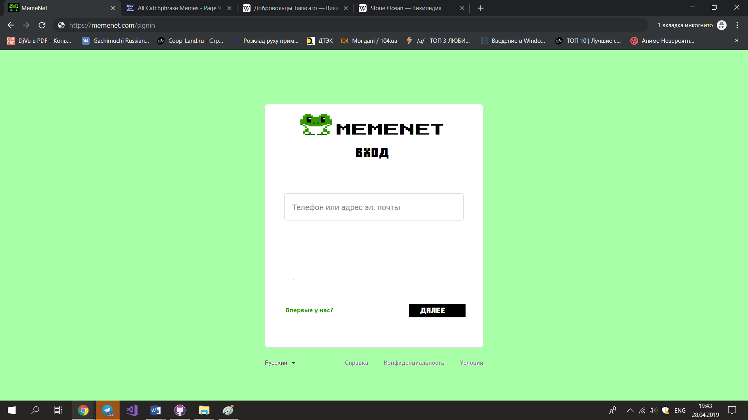

Slide 34
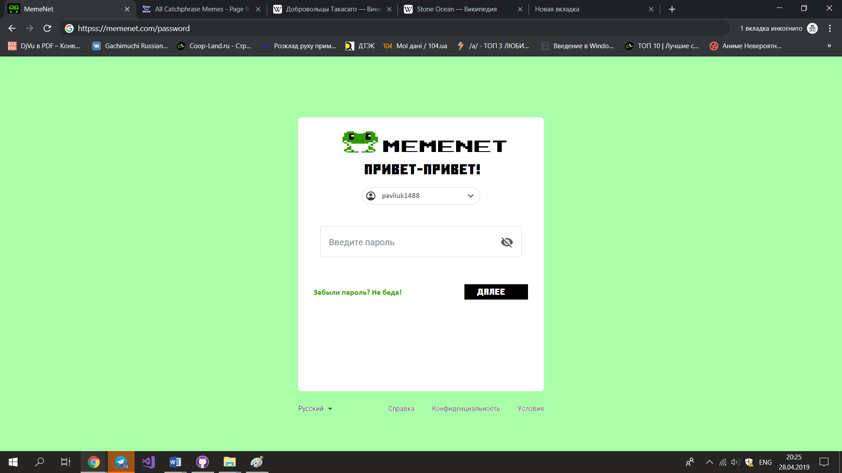

Slide 35
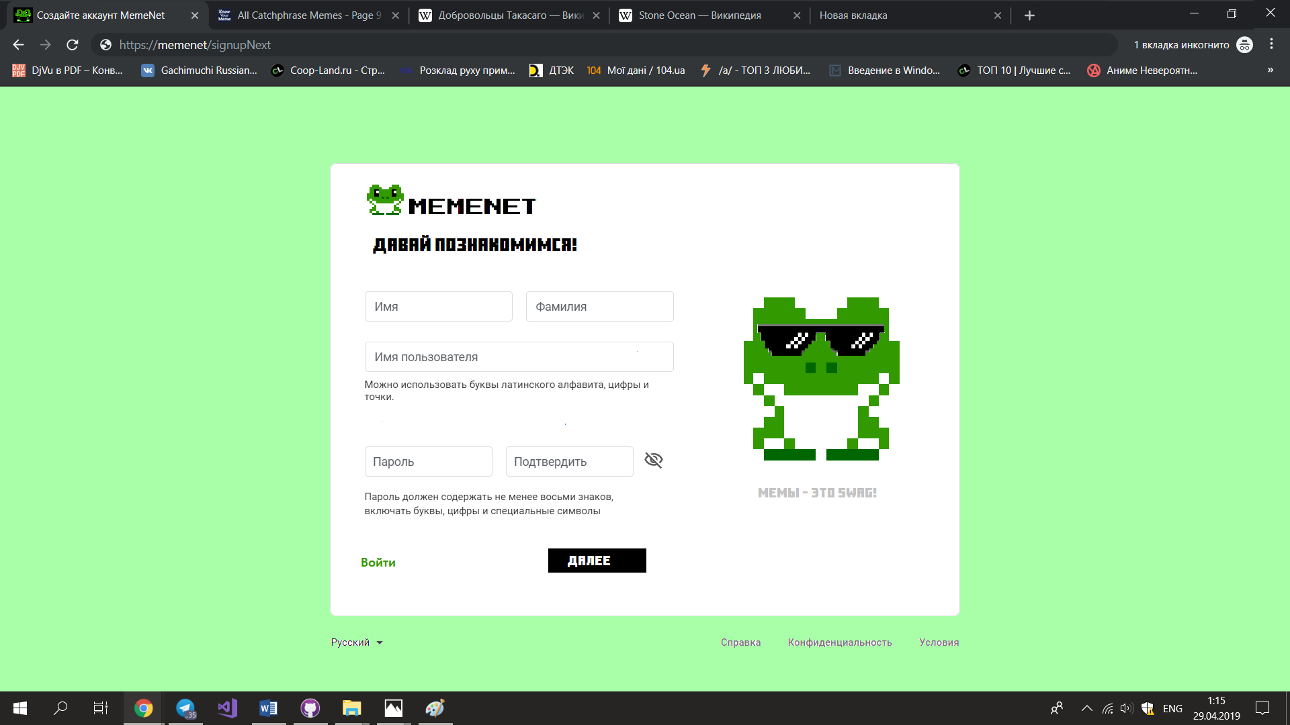

Slide 36
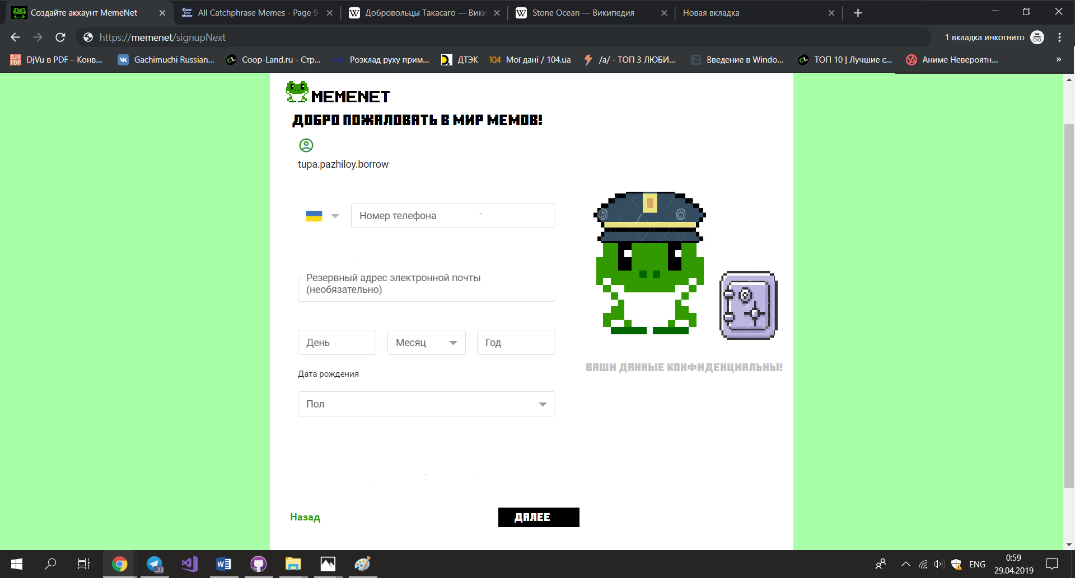

Slide 37
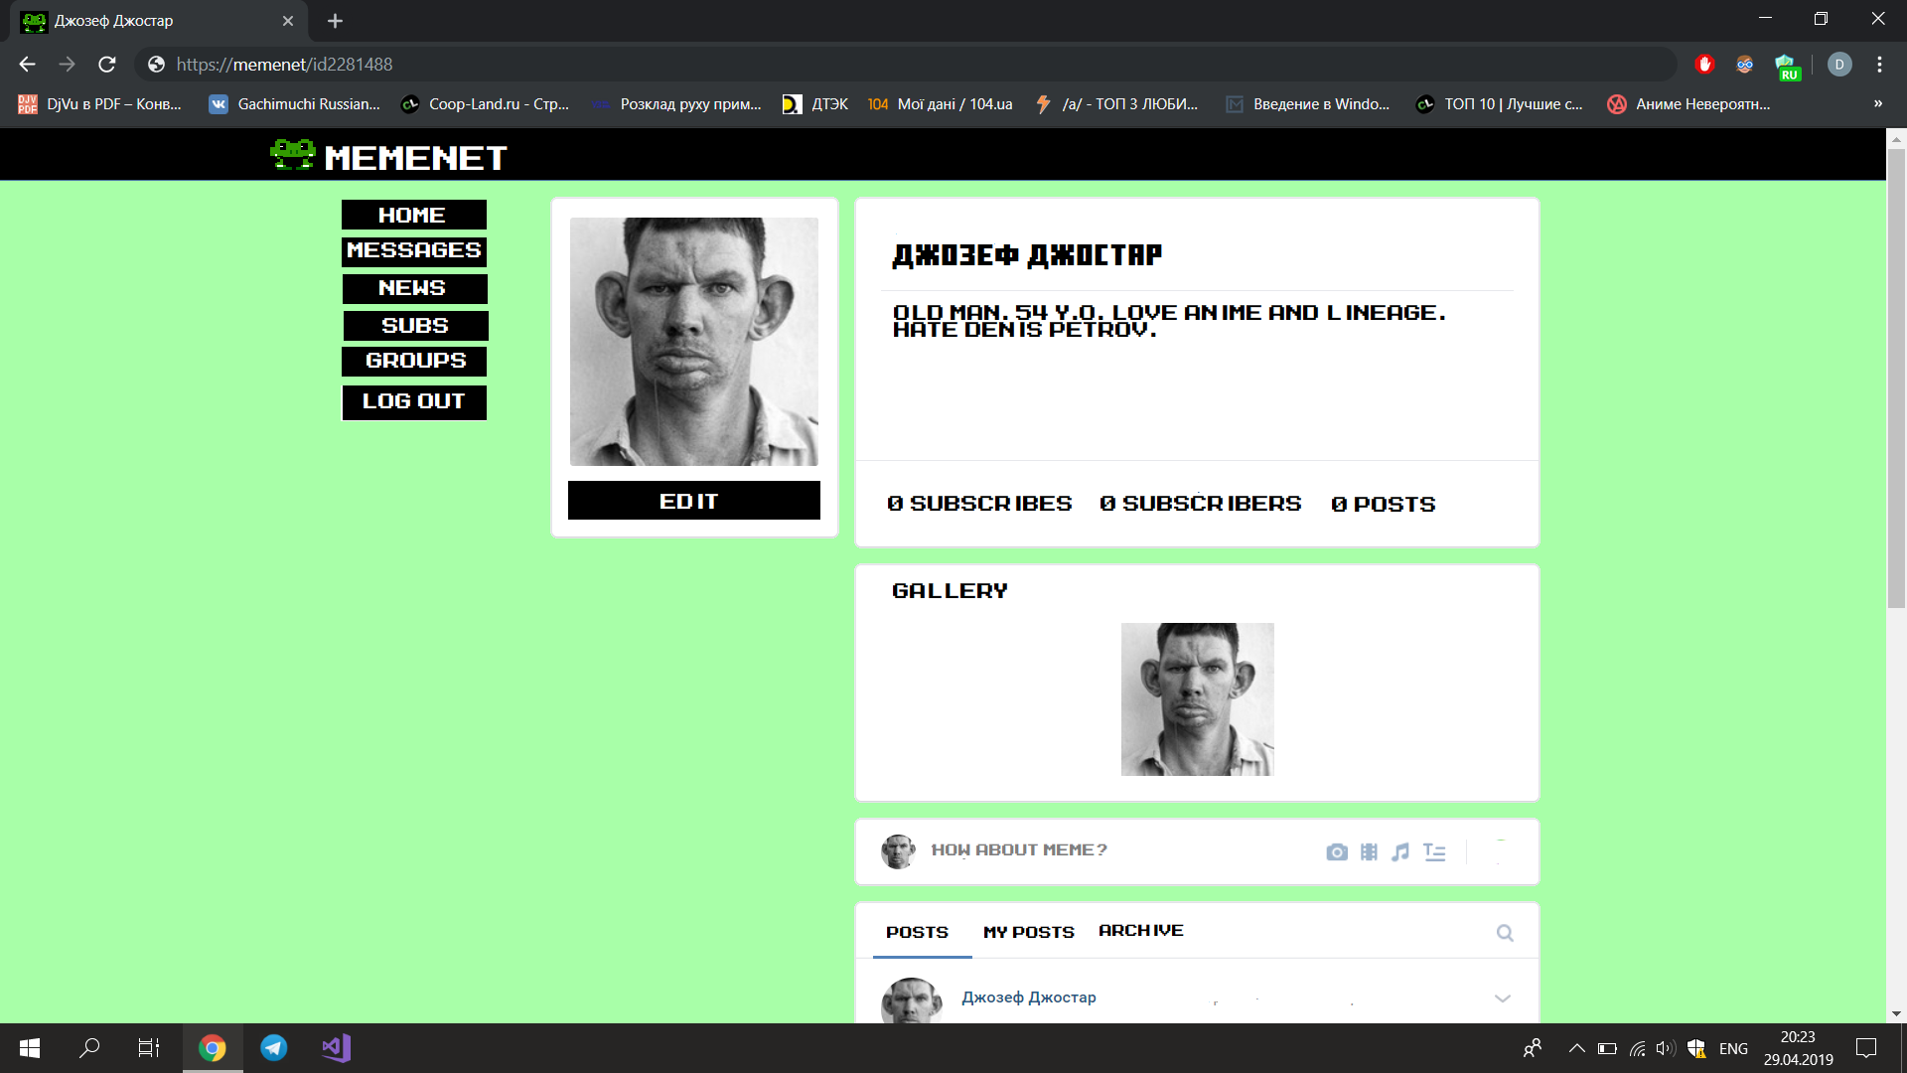

Slide 38
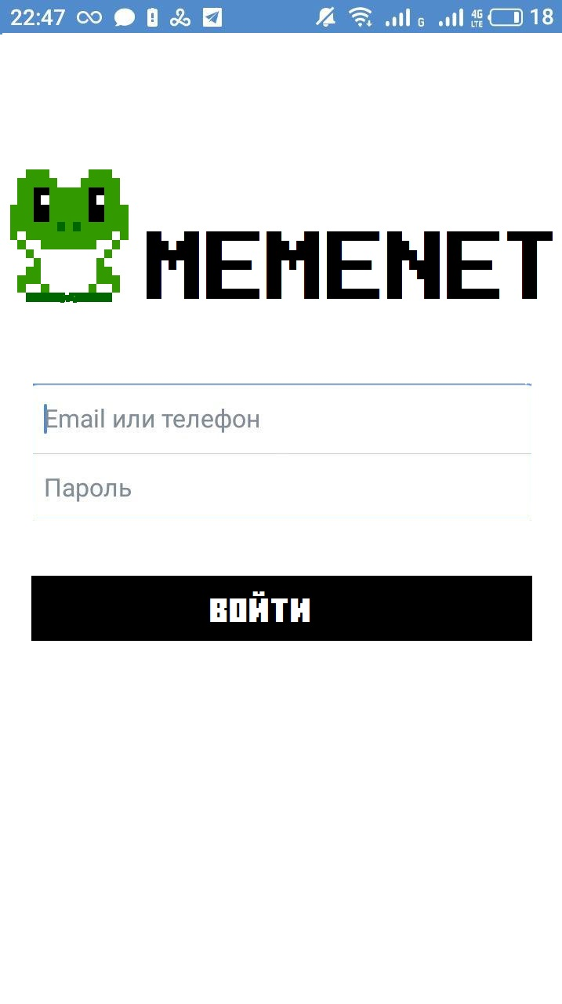
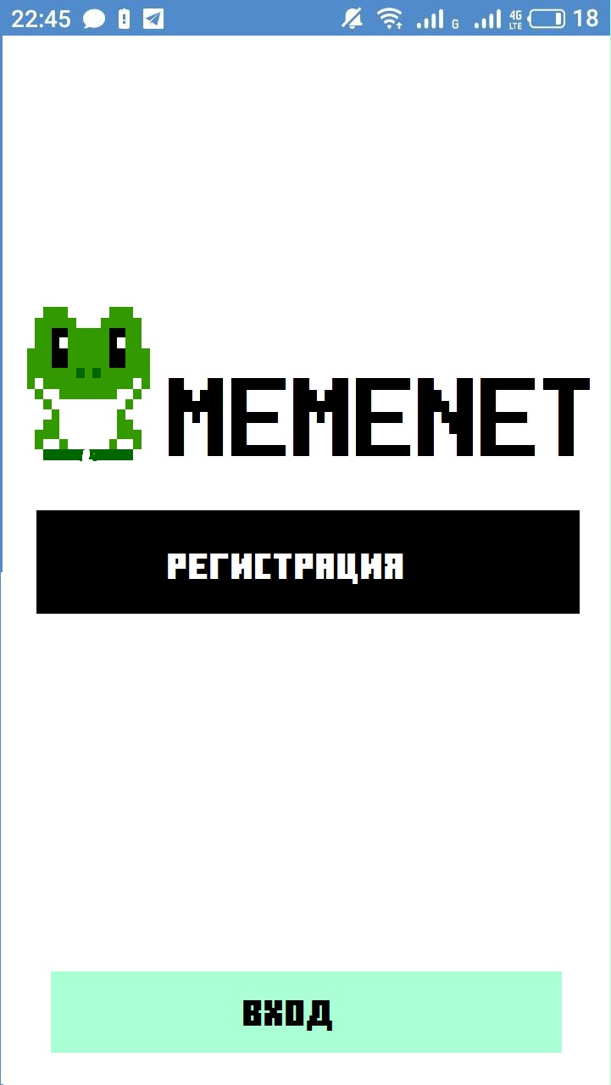
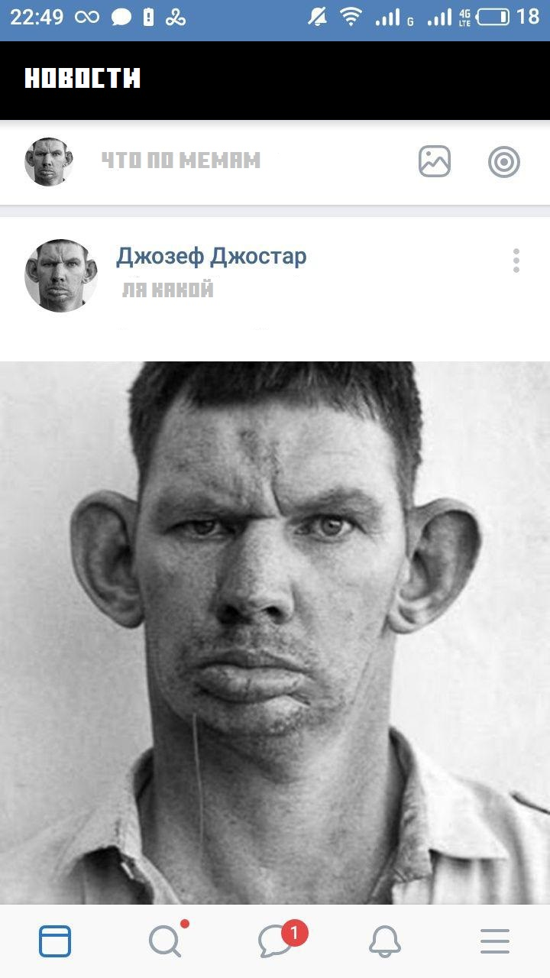

Slide 39
Testing
Unit testing
System testing
Integration testing

Slide 41
Marketing requirements

Slide 42

Business opportunities
Business target
The market problem
Available at this time market solutions
Advantages and benefits for clients

Slide 43

Product strategy
Product development directions
Positioning product
Prising strategy and licensing

Slide 44

Market requirements
Performance requirements
Internationalization requirements
Distribution requirements (Roads to the market)
Priority market table

Slide 45

Forecast for sales and revenues
In best case: pay back for year after release, double profit for 2 years.
In worst case: pay back for 3 years after release, double profit for 6 years.
In most possible case: pay back for 2 years after release, double profit for 4 years.

Slide 46

Estimated expenses and budget
Develop a web-site 6000
Develop a mobile application for Android 7000
Developing a mobile application for iOS 5000
Development of the server part of the application 12000
Product promotion 11000
Server rental and application installation 2000
Layout layout of the application design 4000
Unforeseen expenses 7000
TOTAL 54,000

Slide 47

Segmentation of target market
Adress of target market
Description of the ideal target organization

Slide 48
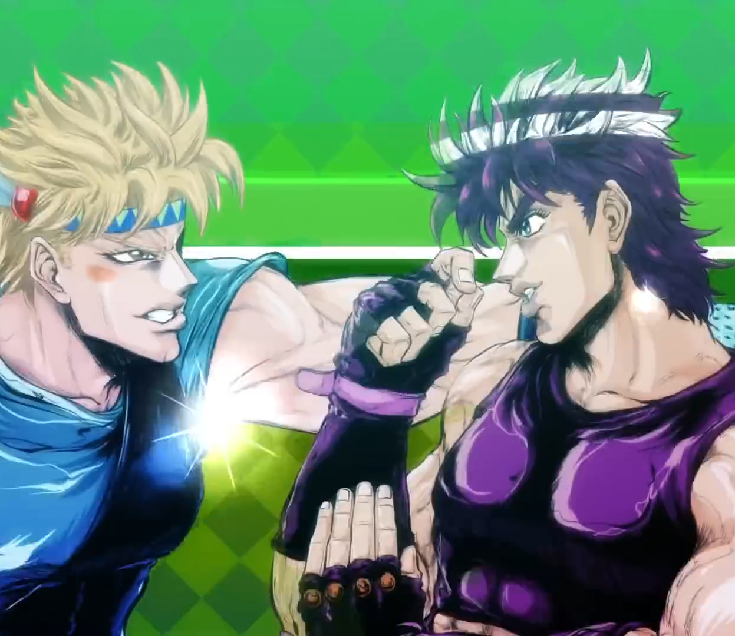
Competitive environment
Trends affecting the competitive environment
Temporary expenses

Slide 49

System requirements
For mobile users: Android devices. Android 5.0 and later with support for Google Play services. iOS devices: iOS 9.0 and later.
For users of desktops and laptops (online version): Firefox browser version 12.0 or higher, Internet Explorer version 9.0 or higher, Safari version 5.0 or higher, or Google Chrome version 18.0 or higher. Operating system Windows 7, Mac OS X version not lower than 10.7, Ubuntu version not lower than 10, or 64-bit Linux OS not lower than 11.

Slide 51
Scale managment

Slide 52
Project scope:
Resources
Project scope
Implementation time
Feature set

Slide 53

Resources Resources consist mainly of the work of developers, testers, designers, manuals.
Resources consist mainly of the work of developers, testers, designers, manuals.
Kosogov Artem - team leader, developer.
Radjabli Elsever -application administrator and developer.
Dmitry Pavliuk - designer, developer.
Pavel Tsiposhchuk - back-end developer.
Doroshenko Renat - chief technical support.

Slide 54
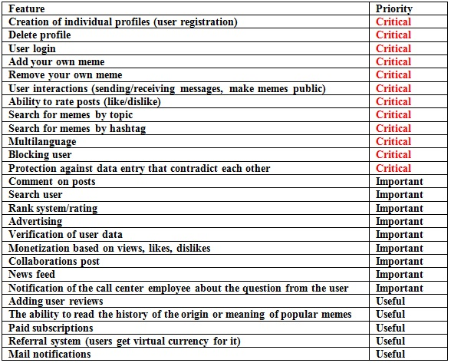
Feature Set

Slide 55
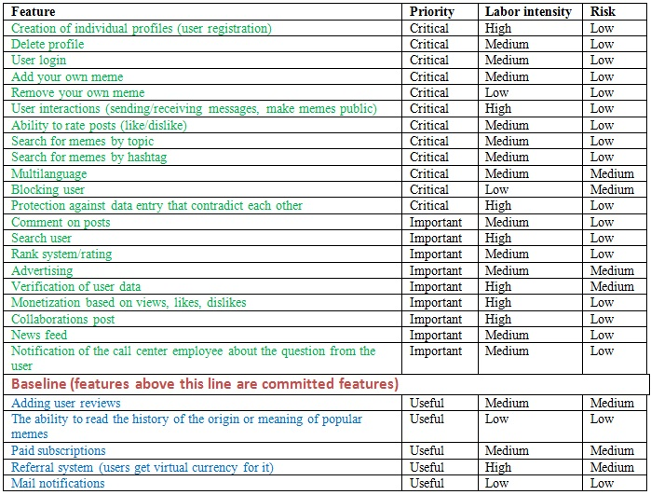
Baseline Definition

Slide 56







Implementation time
Estimated development time - six months.
Meeting with the team​
Writing a document with requirements​
Testing requirements​
Writing and negotiating contracts and other project documents.​
Product development

Slide 58
Refinement of the system's definition

Slide 59


5.2 SRS packages
Modern SRS-package
Creating a software product that can provide social activity and provide an excellent platform for the distribution of youth content.
The project is designed for young people, as well as older people who want to maintain contact with people of the younger generation. Initially it is planned to bring in more than 100 users for testing.

Slide 60
Short List Models Precedents
Global user search
View meme tape
Writing and reading message
Creating a memopedia
Creating and maintaining a community
Add and edit personal data
Search and subscribe to communities
Change user rank
Memobooking
Collaboration
Paid subscription
Participation in the referral program

Slide 61
CHARACTERISTICS OF ACTORS
User | This class of users has access to its account and access to the database with all users, which it can add as friends, communities, to update the news of which it can subscribe. Also have the opportunity to customize the settings for the application and edit your profile. Can create posts and communities.
Moderator | It has access to all user capabilities and also: lock / unlock users and communities
Application Administrator | It has access to all the features of the moderator, as well as the assignment of unique ranks to users.
Database administrator | This type of user has full access to the server with a database, has the ability to edit the database structure, update / add / delete any data from the database.

Slide 62
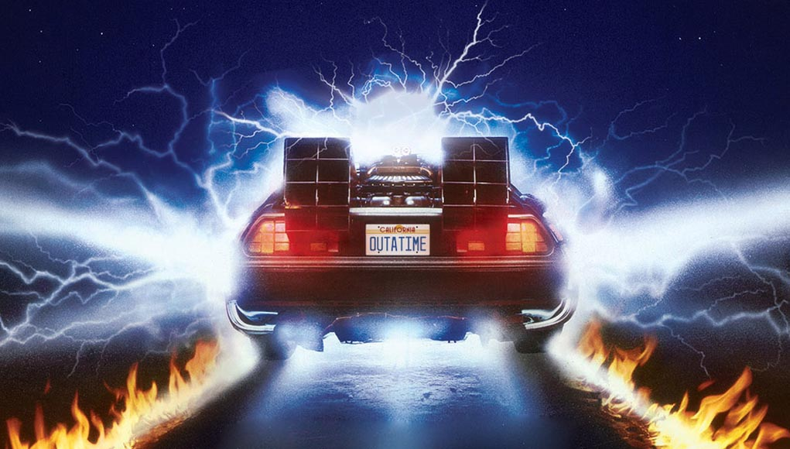
And the rest of this document has already been presented earlier in the presentation.

Slide 63


Slide 64
Trace matrix
^{Functions\Requriements} | Consumer profile | Advertiser Profile | Saving information to the database | List of posts | User list | Configure application settings | Cross platform | Likes dislike system
Add post | + | + | + |  |  |  |  | +
Global user search |  |  |  |  | +
View tape |  |  |  | + |  |  |  | +
Configuration settings |  |  | + |  |  | +
Writing and reading messages | + | + | +
Community Creation and Maintenance | + | + | +
Add and edit personal data | + | + | +
Search and subscribe (paid / free) to communities | + |  | + | +
Saving and restoring database |  |  | + |  |  | + | +
Collaboration | + |  | + | + | +
Referral system | + |  |  |  | +
Monetizing content based on likes or dislikes | + | + |  | + | + |  |  | +

Slide 65
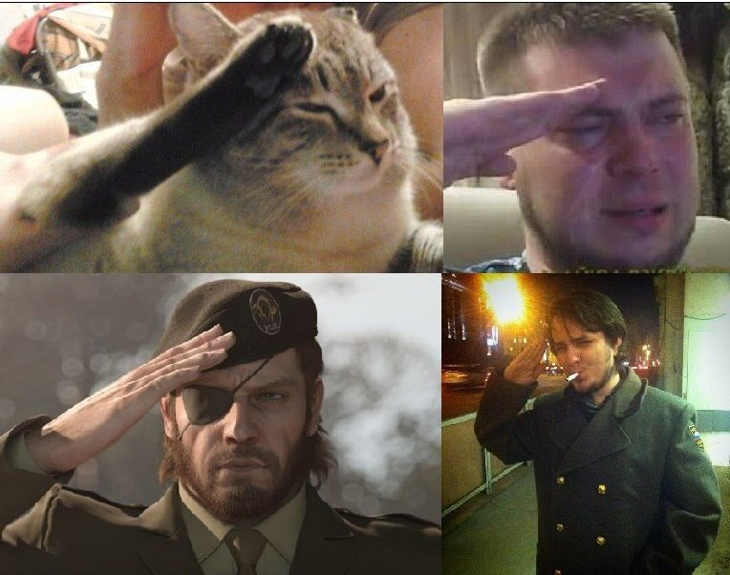
Thanks for attention
I hope you will find me on the Internet, but for now goodbye. Your Memenet.

